Slide 1
Chapter 34

Slide 2
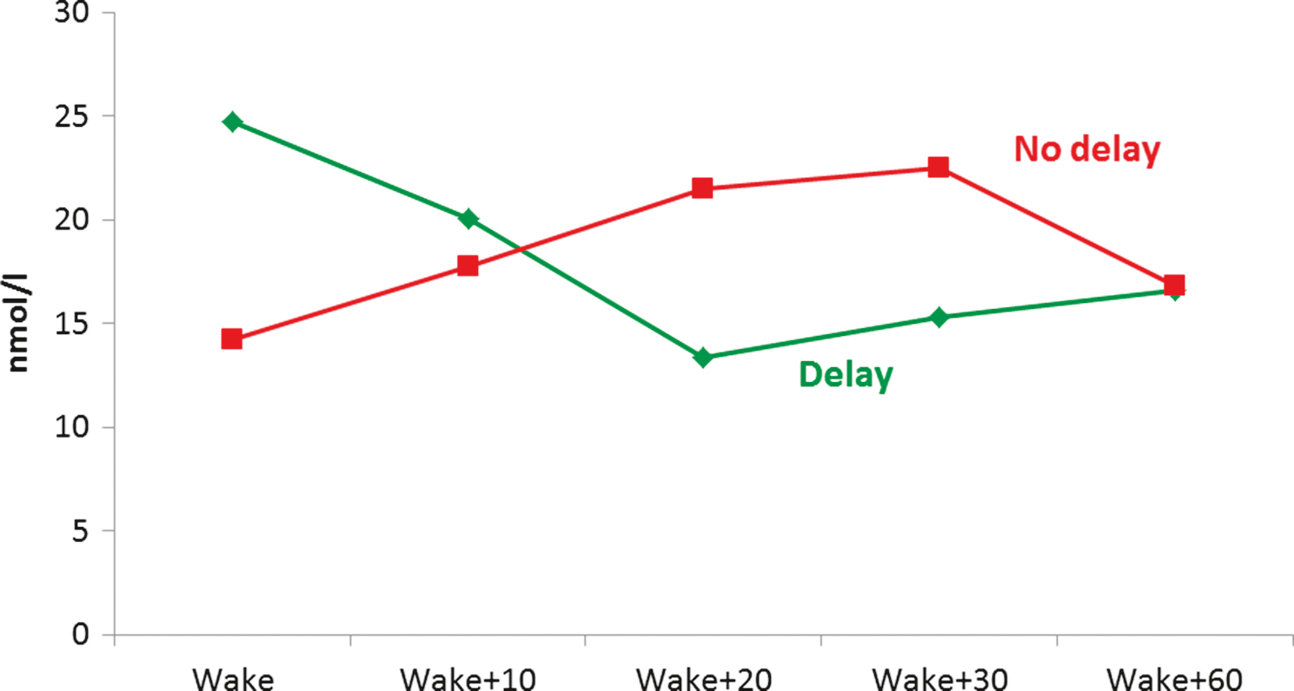
Figure 1 Mean salivary cortisol levels immediately after waking and at 10, 20, 30, and 60 min after waking in elderly volunteers who delayed (green line) and did not delay (red line) saliva sampling after waking in the morning. Error bars are standard errors of the mean.
From Wright and Steptoe.¹¹

Slide 3
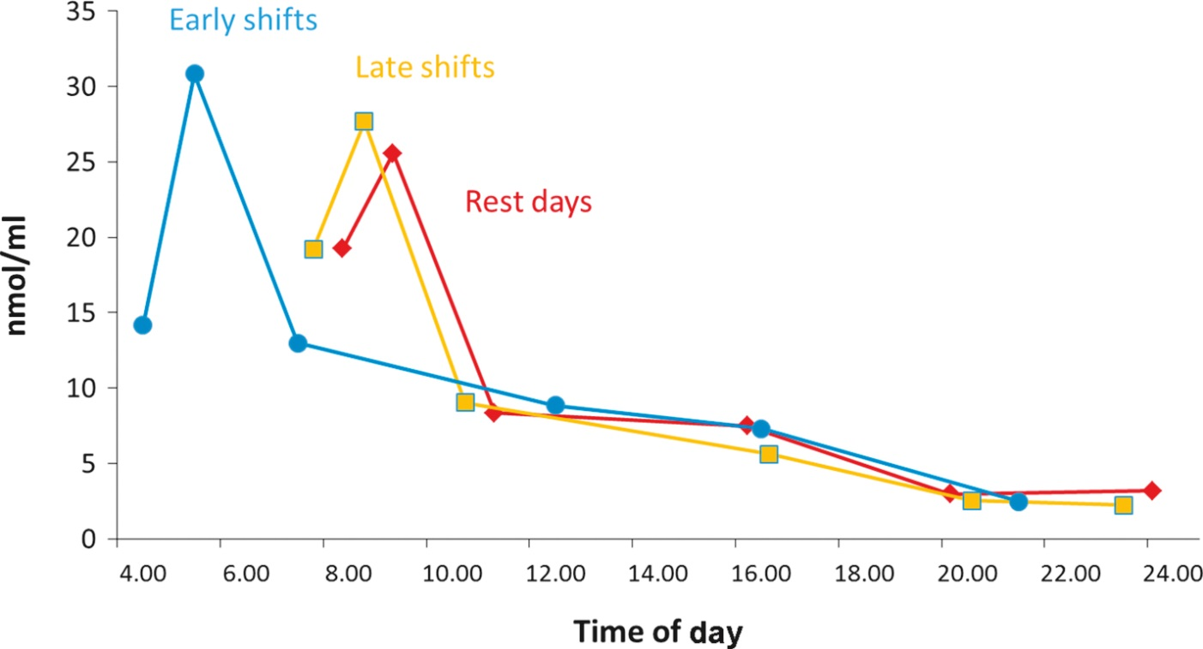
Figure 2 Mean salivary cortisol levels on waking, waking + 30 min, waking + 2.5 h, waking + 8 h, waking + 12 h, and bedtime for early shifts (blue line), late shifts (yellow line), and rest days (red line).
From Bostock and Steptoe.¹⁶

Slide 4
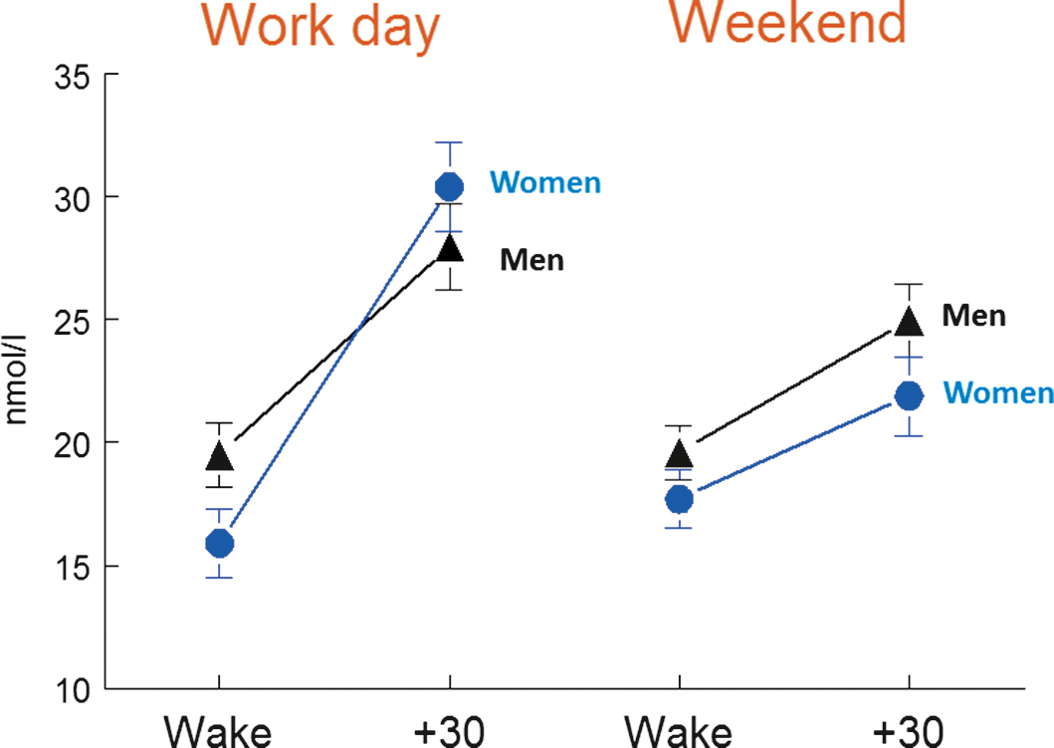
Figure 3 Mean salivary cortisol on waking (wake) and 30 min later (+ 30) on a work day and weekend day in men (black lines) and women (blue lines). Error bars are standard errors of the mean.
From Kunz-Ebrecht et al.²¹

